Slide 1
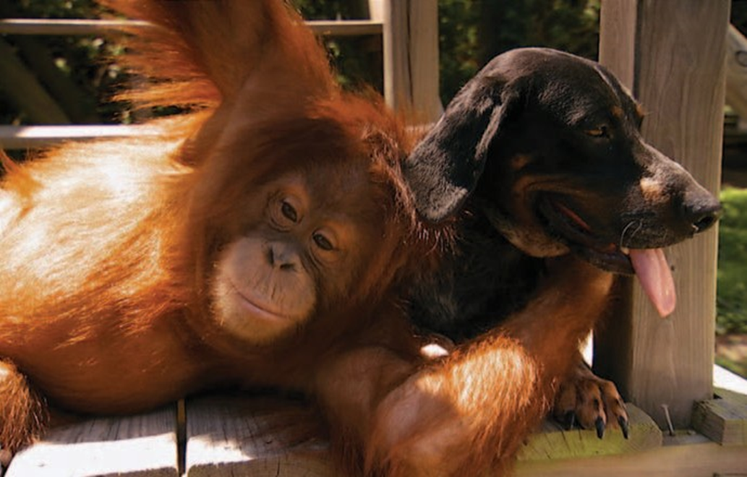
1a Unlikely friends

Slide 2
Listening
1 Work in pairs. Look at the photo. Discuss the questions
What are the two animals in the photo?
Are they normally working animals, pets, wild animals or something else?
What does the photo suggest about these animals’ characters

Slide 3
LISTENING
2 Now listen to an extract from a radio program about an unlikely friendship between these two animals. What things do they do together to enjoy each other’s company?

Slide 4
3 1.2 Listen again and choose the right word to complete each statement.
Co-operation between animals of different species is not______
a natural b easy c usual
2. Dogs are usually _______ apes.
a suspicious of b frightened of c aggressive towards
3. This particular dog and orang-utan behave like __________ .
a old friends b children c people
4. Their behaviour has attracted the interest of a lot of ______ .
a TV viewers b scientists c psychologists
5. Orang-utans are very ______________ creatures.
a physical b naughty c kind
6. Their relationship is based on a need in both animals to________ .
a share new experiences b hunt together c be sociable

Slide 5
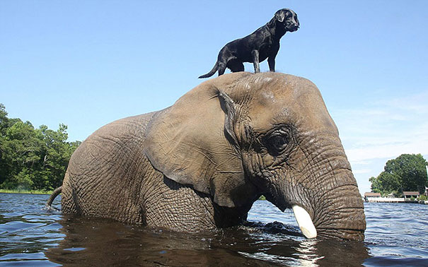
Do you believe animals can have friendships? Or do they form relationships only for practical reasons? Do you know other examples of sociable animals? Discuss.

Slide 6
Example answers
1 Positive: considerate, dependable, energetic, good fun,
outgoing
Negative: selfish, unreliable
Either positive or negative: laid-back, serious, shy
2 (near) opposites: considerate/selfish; dependable/
unreliable; energetic/laid-back; outgoing/shy; good fun/
serious

Slide 7
Extra activity
Personalize and practice the words
by putting them into sentences about family and
friends.
For example : My sister Jo is very
considerate – she never forgets people’s birthdays; My
young son Harry is energetic – he’s always running around.

Slide 8
VOCABULARY
an orang-utan: they are rarely found working, but are
sometimes used in tourism; they are sometimes kept as
pets in people's homes; in the wild they are found in
the forests of Indonesia and Malaysia
a dog (labrador): they are often used by farmers, hunters
and also as guide dogs for the blind or helping dogs for
those with disabilities; they are frequently kept as pets;
domesticated dogs do not usually live in the wild

Slide 9
Vocabulary Notes
co-operate = to work together with other people to achieve something
hunt = to find and follow animals in order to kill them
(zoo) keepers = people who look after animals at a zoo
rare species = types of animals that aren’t common
sanctuary = a place where people (or, here, animals) go to
be looked after and to find peace
hound dog = any of several different breeds of dogs that
are often used for hunting
compound = here, an area, usually with a fence or wall
around it
just like us = similar to us (people)

